Slide 1
Release Three
Senior Design
Notes:
Anthony

Slide 2
Agenda
Progress
Behaviors
Testing, Builds, Code Analysis
Revised Architecture Diagram
Demo
Plans for next semester
Notes:
Anthony

Slide 3
Progess
Buckled down on Behaviors processes
If not done, in progress
Developed API to control camera with gphoto2 library
Set up environment for front end development
Developed simple front end, hardware web server, and camera control
Built prototype that represents communication across project components
FINALLY PUSHED CODE!!!
Notes:
Anthony

Slide 4
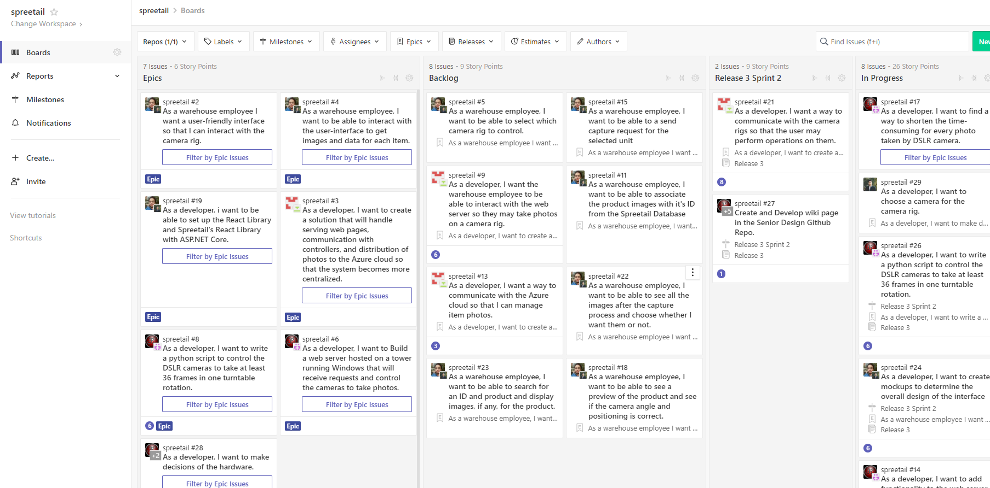
Behaviors - Story Tracking
Staap (Zenhub)
Notes:
Jared

Slide 5
Testing, Builds, and Code Analysis
Unit testing
Unit tests for camera control with server tests planned
Using unittest library for python testing
Builds
Using Gitlab’s CI pipelines to automate builds for every push
Spreetail uses Docker - Puts code into “containers”
Will use docker build commands for CI
In progress, ran into issues when running Docker commands in Gitlab
Code Analysis
Can easily use code analysis tools along with Docker once debugged
Notes:
Jared

Slide 6
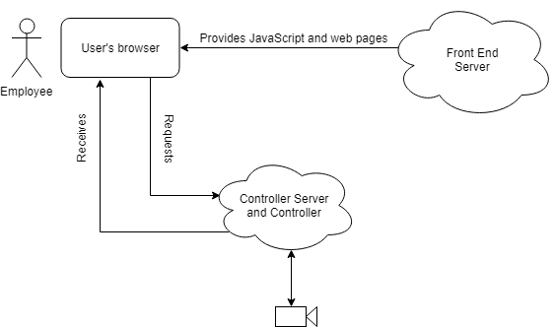
Revised Architecture Diagram
Consolidated web server team into the controller team
User will now communicate directly with the camera rig
Will still host a server for the web pages, but it does not take the role as the middleman
Notes:
Taher

Slide 7
Demo
Front End sends request to web server to have camera take image and return it
Web server receives request, uses camera control API to take image
Web server returns photo to front end
Front end displays image on web page
Notes:
Taher

Slide 8
Next Semester
Notes:
Anthony

Slide 9
Team Times
At Spreetail
Monday, Tuesday, Thursday from 5pm to 8pm
On campus
Wednesday from 10am to 12pm
Notes:
Li

Slide 10
Next Release
Hardware
Multiple simultaneous camera control
Build full hardware rig - Linux tower, cameras, tripod, etc.
Web Server
Develop code to send many photos at once
Make connection with Spreetail’s Azure blob
Front End
Mock up designs
Layout fixes
Apply Spreetail design rules to project
Notes:
Li

Slide 11
Release 5
Send requests to specific hardware unit(s)
Display images in a way that is easy to view
Select photos to be saved/deleted on front end
Build final solution to test at Spreetail
Perform tests at warehouse
Notes:
Yang

Slide 12
Release 6
Wrap up unfinished stories (hopefully none)
Test all aspects of project
Finalize all documentation for project
Extended Scope items (if time allows)
Notes:
Yang

